Slide 1

ECO TRACE
Tracking Our Footprint, Building a Greener Future

Slide 2





Our Team
Corina Lonelia Research & Planning
M Sohaib Ramzan Research & Implementation
Adhithya Vel M V Leader & Design
Harikaran M Research & Analysis

Slide 3

Agenda
01 - The Problem we are solving
02 - What is Eco-trace?
03 - The Solutions we provide
04 - Our Market Strategy
05 - Conclusion we come to!

Slide 4
Agenda
01 - The Problem we are solving
02 - What is Eco-trace?
03 - The Solutions we provide
04 - Our Market Strategy
05 - Conclusion we come to!

Slide 5
Agenda
01 - The Problem we are solving
02 - What is Eco-trace?
03 - The Solutions we provide
04 - Our Market Strategy
05 - Conclusion we come to!

Slide 6
Agenda
01 - The Problem we are solving
02 - What is Eco-trace?
03 - The Solutions we provide
04 - Our Market Strategy
05 - Conclusion we come to!

Slide 7
Agenda
01 - The Problem we are solving
02 - What is Eco-trace?
03 - The Solutions we provide
04 - Our Market Strategy
05 - Conclusion we come to!

Slide 8

The Problem
"Climate change is happening, humans are causing it, and I think this is perhaps the most serious environmental issue facing us." - Bill Nye

Slide 9
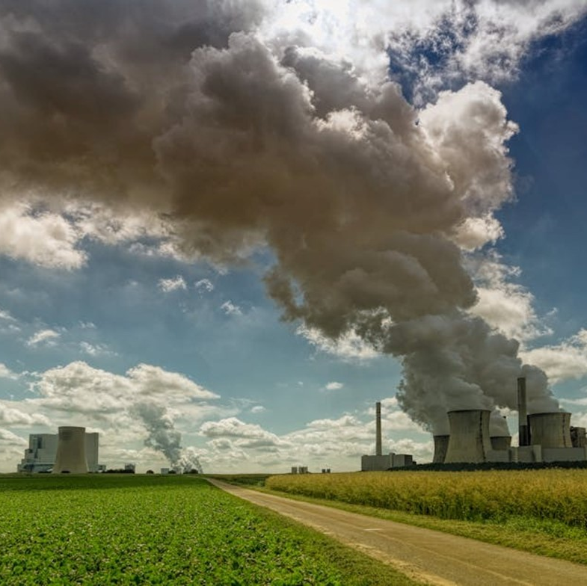
Challenges
Climate Change: CO₂ traps heat, leading to rising temperatures and extreme weather events.​
Sea-Level rise: Melting ice contributes to coastal flooding and erosion.
Health Impacts: Air pollution worsens respiratory diseases, while heatwaves pose health risks.
Environmental Degradation: Harms ecosystems, leading to biodiversity loss, contamination of soil and water, affecting wildlife and ecosystems.

Slide 10
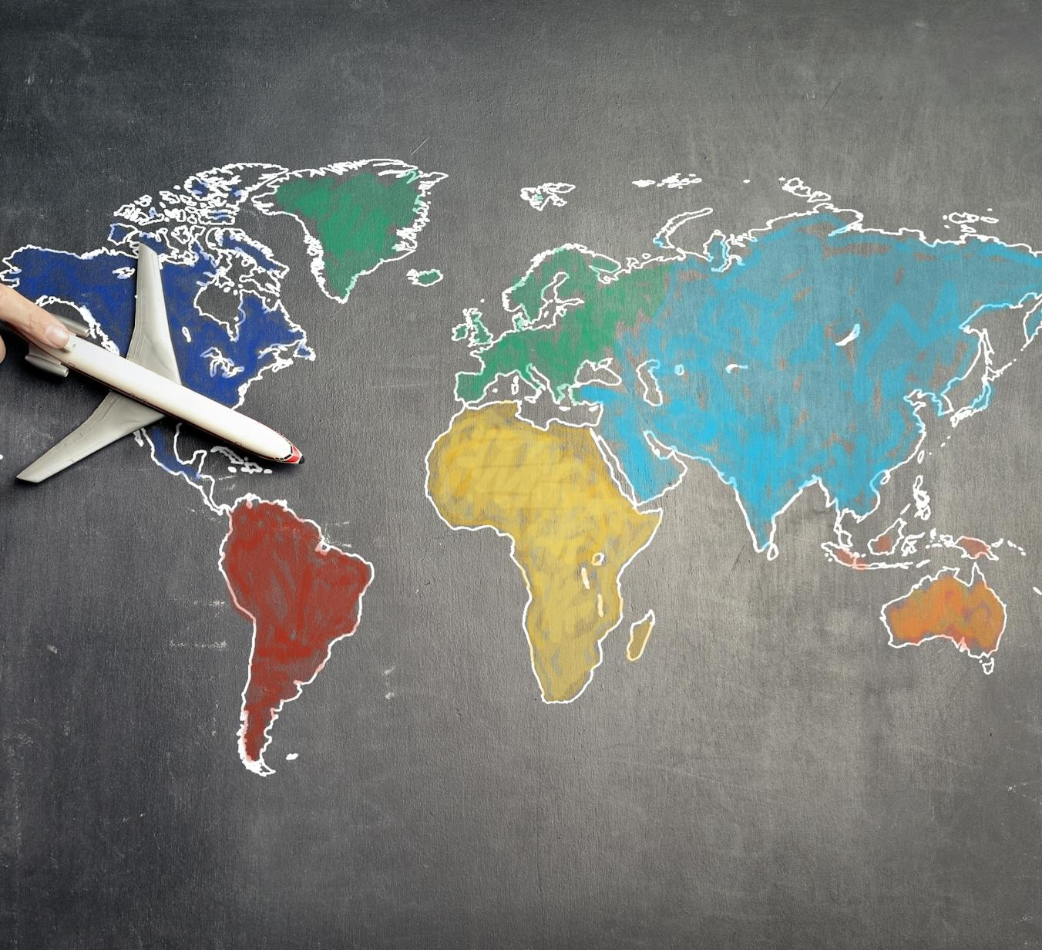
Statistics
According to BBC The average temperature at the Earth's surface has risen about 1.1°C since 1850.
In 1950 the world emitted 6 billion tones of CO2. By 1990 this had quadrupled, and we now emit over 35 billion tones each year.
The global sea level has increased by around 90 millimeters since 1993, at an average of 2.9 millimeters per year.
According to Health Effects Institute. State of Global Air 2020. In 2019, air pollution caused more than 6.67 million deaths, accounting for nearly 12% of global deaths

Slide 11
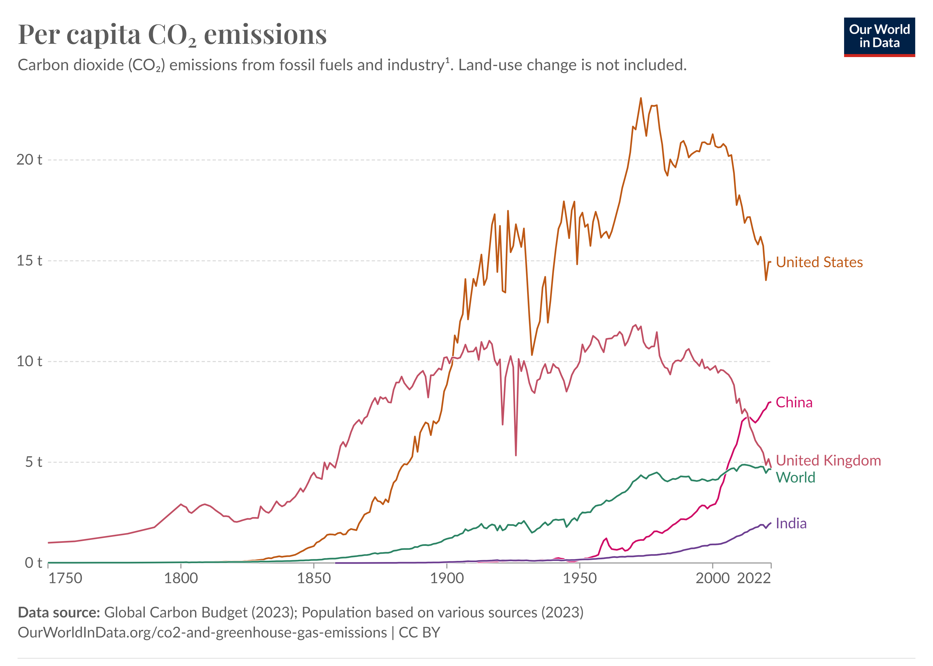
Statistics

Slide 12

Solutions we provide
Why do we need it?
Reduce, Reuse and Recycle waste
Turn off electrical appliances when we are not using them.
Plant trees.
Use 'green' electricity from solar panels and wind turbines.
Walk, cycle or use public transport

Slide 13
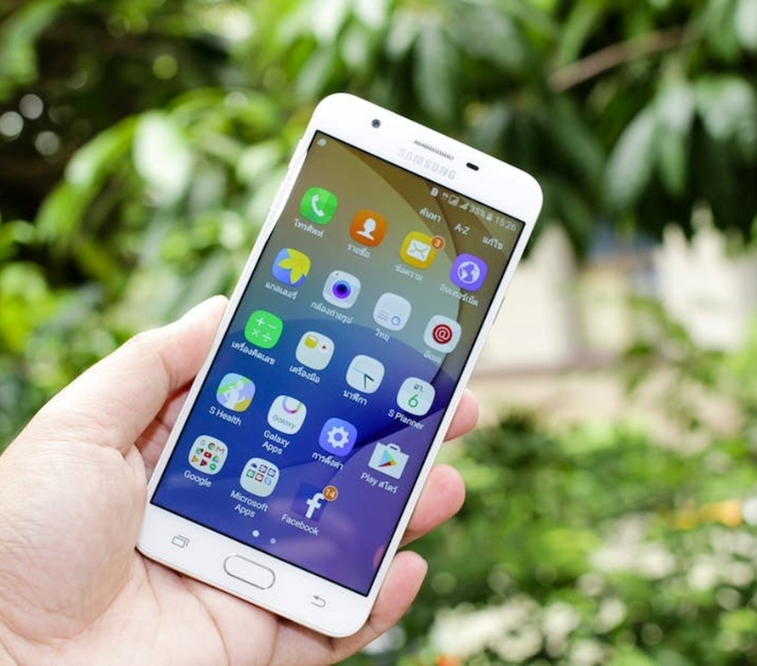
What is EcoTrace?
A pioneering carbon footprint tracking app, on a mission to transform sustainability practices

Slide 14

Overview
Features Of App​
Calculate your Carbon Footprints​
Show Climate Impact graph​
Shrink your Footprint Further
Main purpose Of App
Help people to reduce their carbon emission.
To create awarness and importance to take actions across individuals.

Slide 15
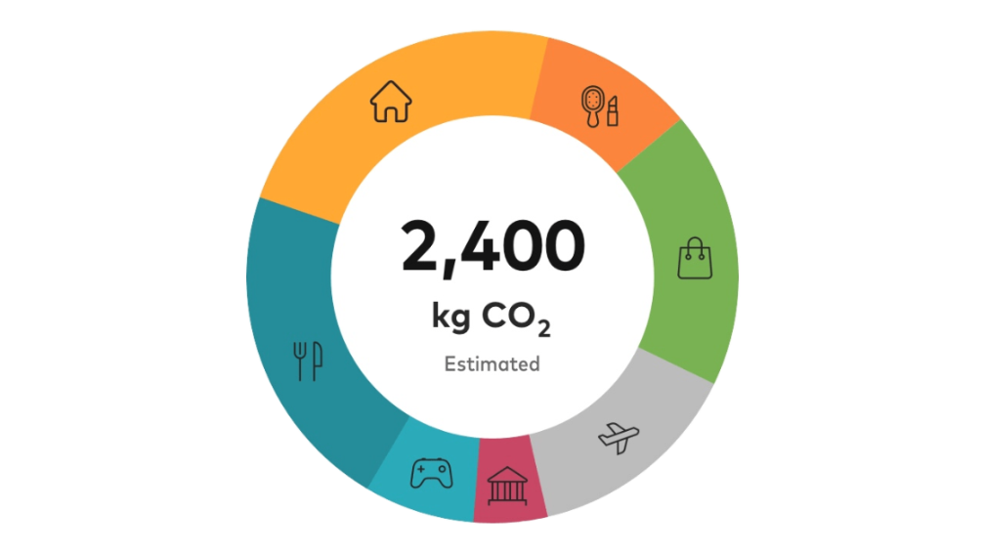
Product Implementation
How will this App interact and work with the user
Calculate Carbon footprint
By analyzing your daily activities, EcoTrace will calculate your carbon footprints.
2. Show Climate Impact Graph
Eco-Trace will show your contribution in reducing carbon footprint.
3. Describe ways to reduce C-Fs
For Example:​
Use bicycle (10km-2kg)​
Watch TV less (3hrs-170grams)​
Eat Non-veg less (1month-4kg)

Slide 16
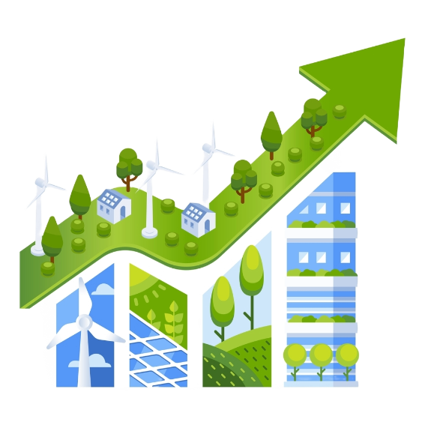
Product Implementation
How will this App interact and work with the user
Calculate Carbon footprint
By analyzing your daily activities, EcoTrace will calculate your carbon footprints.
2. Show Climate Impact Graph
Eco-Trace will show your contribution in reducing carbon footprint.
3. Describe ways to reduce C-Fs
For Example:​
Use bicycle (10km-2kg)​
Watch TV less (3hrs-170grams)​
Eat Non-veg less (1month-4kg)

Slide 17
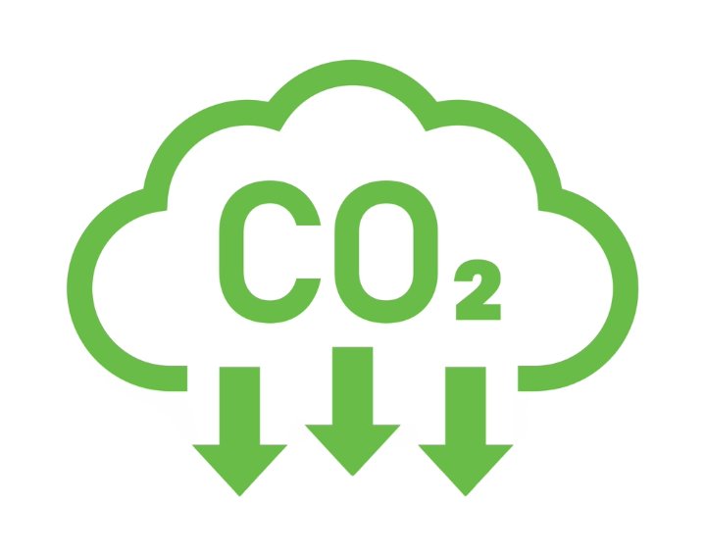
Product Implementation
How will this App interact and work with the user
Calculate Carbon footprint
By analyzing your daily activities, EcoTrace will calculate your carbon footprints.
2. Show Climate Impact Graph
Eco-Trace will show your contribution in reducing carbon footprint.
3. Describe ways to reduce C-Fs
For Example:​
Use bicycle (10km-2kg)​
Watch TV less (3hrs-170grams)​
Eat Non-veg less (1month-4kg)

Slide 18

Our Market Strategy
The art of aligning innovation with consumer desires, creating a pathway where products meet purpose in the marketplace

Slide 19

Market Overview
Target Audience: Eco Trace aims to target environmentally conscious individuals and businesses seeking to reduce their carbon footprint and contribute to sustainability efforts.
Value Proposition: EcoTrace offers a user-friendly carbon footprint tracking app equipped with personalized recommendations and actionable insights to empower users in making eco-conscious decisions.
Competitive Analysis: Through a thorough analysis of existing carbon footprint tracking apps, EcoTrace distinguishes itself by leveraging advanced technologies like computer vision for accurate data analysis and personalized recommendations.
Promotional Strategies: EcoTrace will implement promotional strategies such as referral programs, offering free trials, and organizing awareness campaigns to generate interest and encourage adoption among individuals and businesses.
Customer Engagement: We prioritize customer engagement through responsive customer support, regular updates based on user feedback, and community-building initiatives to foster a strong and loyal user base.

Slide 20
Financial Distribution
Cost Category | Estimated Range
Development Cost
- App Development | £40,000 - £120,000
- Server Infrastructure | £5,000 - £15,000
- Testing and QA | £5,000 - £20,000
Maintenance Cost
- Regular Updates | £10,000 - £30,000
- Security Measures | £5,000 - £15,000
- Server Maintenance | £2,000 - £8,000
Data Integration
- Carbon Footprint Data | £5,000 - £20,000
- User Data | £2,000 - £8,000 per year
Marketing
- Promotion | £10,000 - £50,000
- Content Creation | £5,000 - £15,000 per year

Slide 21

Financial Summary
The development cost includes coding, design, and server infrastructure to ensure a user-friendly and reliable platform. Thorough testing processes are also vital to identify and rectify any issues, ensuring a smooth user experience.
The maintenance cost covers regular updates, security measures, and server maintenance to ensure ongoing functionality, data protection, and optimal performance of the app.
The Data Integration cost involves incorporating carbon footprint and user data, ensuring accurate tracking and personalized recommendations for users. It includes expenses for organizing and managing these datasets securely and efficiently within the app infrastructure.
The marketing cost for EcoTrace includes promotion and content creation to generate awareness, engage users, and drive adoption. It includes expenses for advertising campaigns, social media outreach, and creating compelling content to highlight the app's value proposition and benefits.

Slide 22



Road Map
Planning
Analysis
2024

Slide 23




Road Map
Design and Development
Testing
2025

Slide 24


Road Map
Implementation
Launch
2026

Slide 25

Conclusion
Discussion.
What is Special about us?
What makes us unique?

Slide 26
References
BBC Bitesize. (n.d.). Greenhouse gases and climate change - Humans and the environment - KS3 Biology. [online] Available at: https://www.bbc.co.uk/bitesize/articles/zq2m2v4#zrxt6g8 [Accessed 19 Mar. 2024].
Crook, I. (2019). App Marketing: The Ultimate Guide to App Marketing Strategies. [online] AppInstitute. Available at: https://appinstitute.com/app-marketing/.
Cycles, T. text provides general information S. assumes no liability for the information given being complete or correct D. to varying update and Text, S.C.D.M. up-to-Date D.T.R. in the (n.d.). Topic: Sea level rise. [online] Statista. Available at: http://www.statista.com/topics/11260/sea-level-rise/ [Accessed 19 Mar. 2024].
Fazeli, S. (n.d.). Degree project in SMART CITY: A PROTOTYPE FOR CARBON FOOTPRINT MOBILE APP. [online] Available at: https://www.diva-portal.org/smash/get/diva2:751876/FULLTEXT01.pdf.
Greenly.earth. (n.d.). Build your carbon footprint app - Greenly. [online] Available at: https://greenly.earth/en-gb/blog/greenly/build-your-own-application-for-the-climate-app-store [Accessed 20 Mar. 2024].

Slide 27
References
Hoffmann, S., Lasarov, W. and Reimers, H. (2022). Carbon footprint tracking apps. What drives consumers’ adoption intention? Technology in Society, p.101956. doi:https://doi.org/10.1016/j.techsoc.2022.101956
Oliani, M. (2021). Sustainability Apps and Social Practices: Exploring How Carbon Footprint Apps Seek to Change User Practices Can Carbon footprint apps be significant tools in aiding the fight against climate change? [online] Available at: https://edepot.wur.nl/549507.
Ritchie, H. and Roser, M. (2020). CO2 emissions. [online] Our World in Data. Available at: https://ourworldindata.org/co2-emissions.
Srivastava, S. (2024). Mobile App Development Cost UK: A Comprehensive Guide. [online] Appinventiv. Available at: https://appinventiv.com/blog/how-much-does-it-cost-to-build-a-mobile-app-in-uk/ [Accessed 19 Mar. 2024].
www.linkedin.com. (n.d.). How can smartphone apps help users track and offset their carbon footprint? [online] Available at: https://www.linkedin.com/advice/0/how-can-smartphone-apps-help-users-track-offset.

Slide 28

ANY QUESTIONS ?

Slide 29

Thank you

